Slide 1
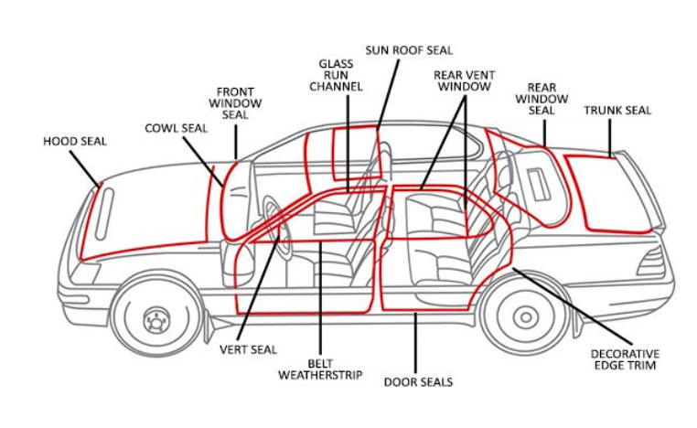
KARTIK TOols and Moulds
(we talk about-----Toolings)
An ISO 9001: 2015 Company

Slide 2
Infrastructure
Plant 1: 9000 square feet
174D, Anand Ind Estate, Mohan Nagar, Ghaziabad
Plant 2: 15000 Sqaue feet
Plot no 4, B Block, Gali No 1, DUHAI Ind Area, Ghaziabad
Group Companies
KANAGATA Technologies Pvt Ltd
SAP Laser and Automation Pvt Ltd

Slide 3
Equipments
CNC Wirecut EDM Mitsubishi MV1200S (400*300*220) - 01 No
CNC Wirecut EDM Electronica Sprintcut (400*300*200) - 01 No
VMC COSMOS VCM1060 (1050*650*600) - 02 No.
VMC Cosmos VCM640 (650*450*500) - 01 No
CNC Laser cutting 3000*1500 mm- 2 KW - 01 no
CNC bending 3200mm, 125 Tons - 01 no
ZNC EDM Joemars - 01 No
CNC Lathe Dia 250*500 mm - 01 No
Milling Machines - 04 No
Surface Grinder - 05 Nos.
Lathe machine - 01 No
Drilling machine - 02 No.

Slide 4
ORGANISATION STRUCTURE
LALIT KUMAR
TOTAL MANPOWER 52 NOS
PURCHASE/ ADMIN- 4 NOS
TOOL/ SPM DESIGN-05 NOS
MOULD DESIGN -02 NOS
TOOL ROOM SUPERVISOR -02 NOS
VMC PROGRAMMER AND OPERATORS-05 NOS
WIRE CUT PROGRAMMER AND OPERATORS-03 NOS
MILLING OPERATORS- 04 NOS
Grinding operators-06 NOS
TURNER - 2 NOS
MOULD FITTERS- 3 NOS
INSPECTION -2 NO
TOOL FITTERS – 5 NOS
MACHINE FITTERS- 8 NOS

Slide 5
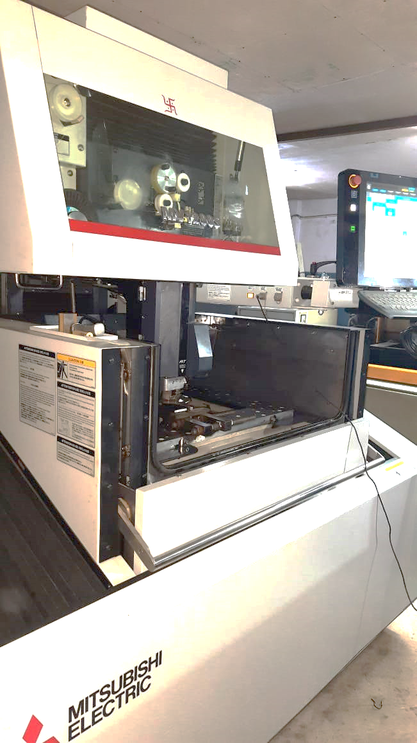
CNC Wirecutting Machine

Slide 6
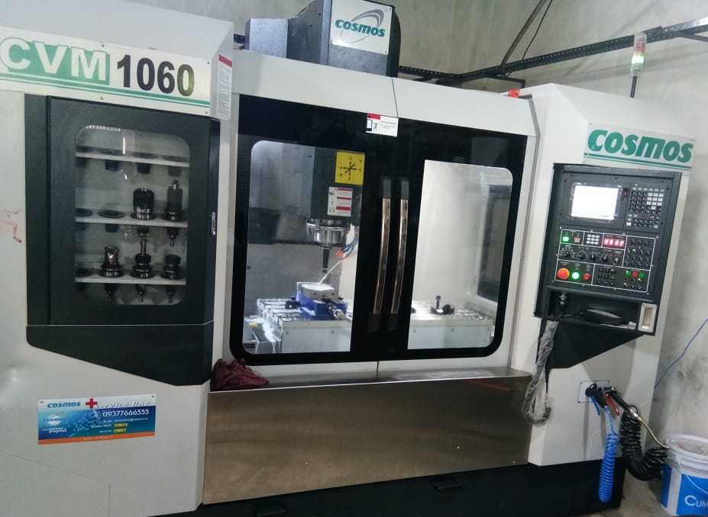
VMC machine

Slide 7
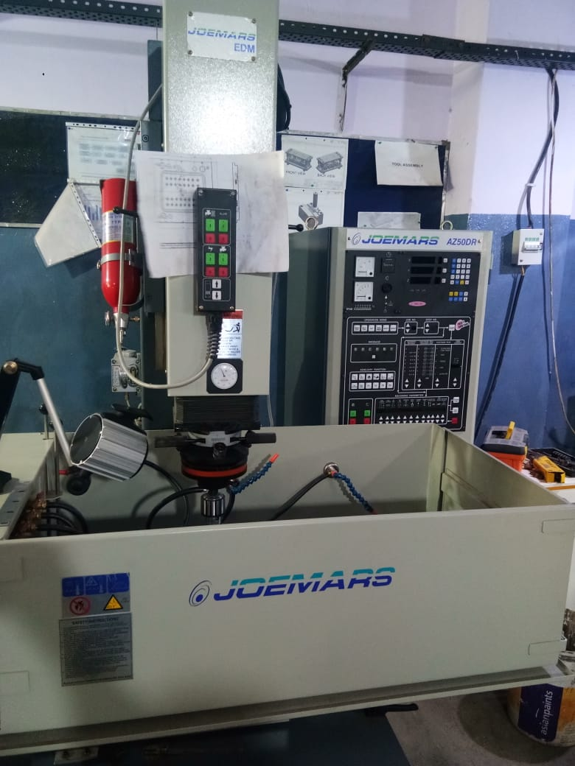
EDM machine

Slide 8
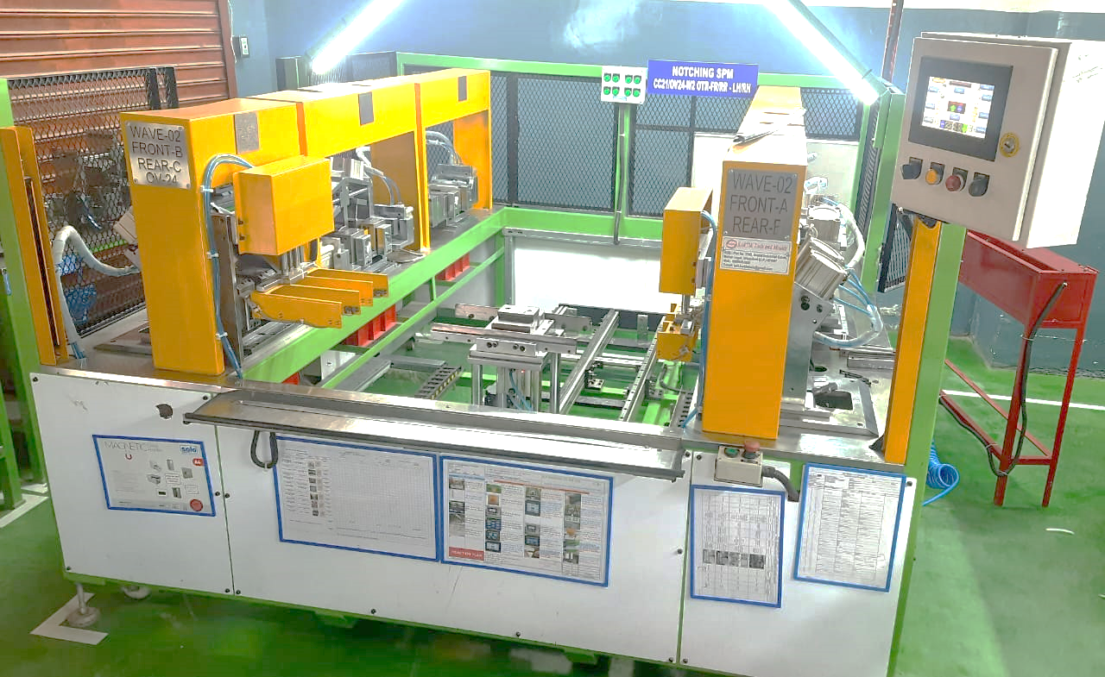
Outer belt 6 station CUT and Notch machine

Slide 9
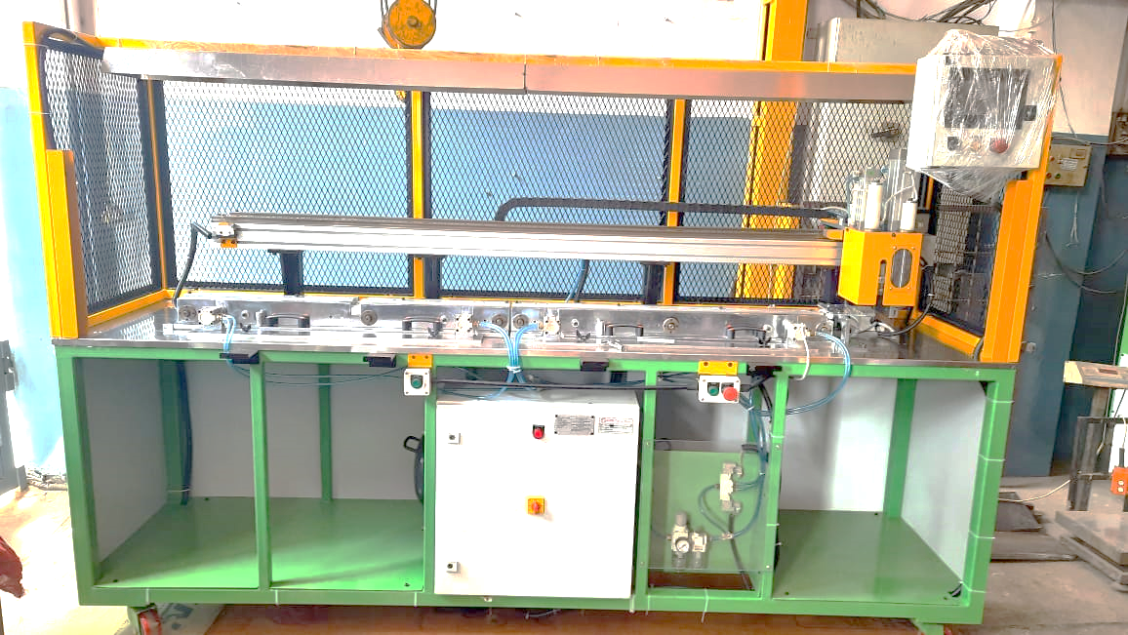
Door seal Clip pitch drilling and cut to length machine

Slide 10
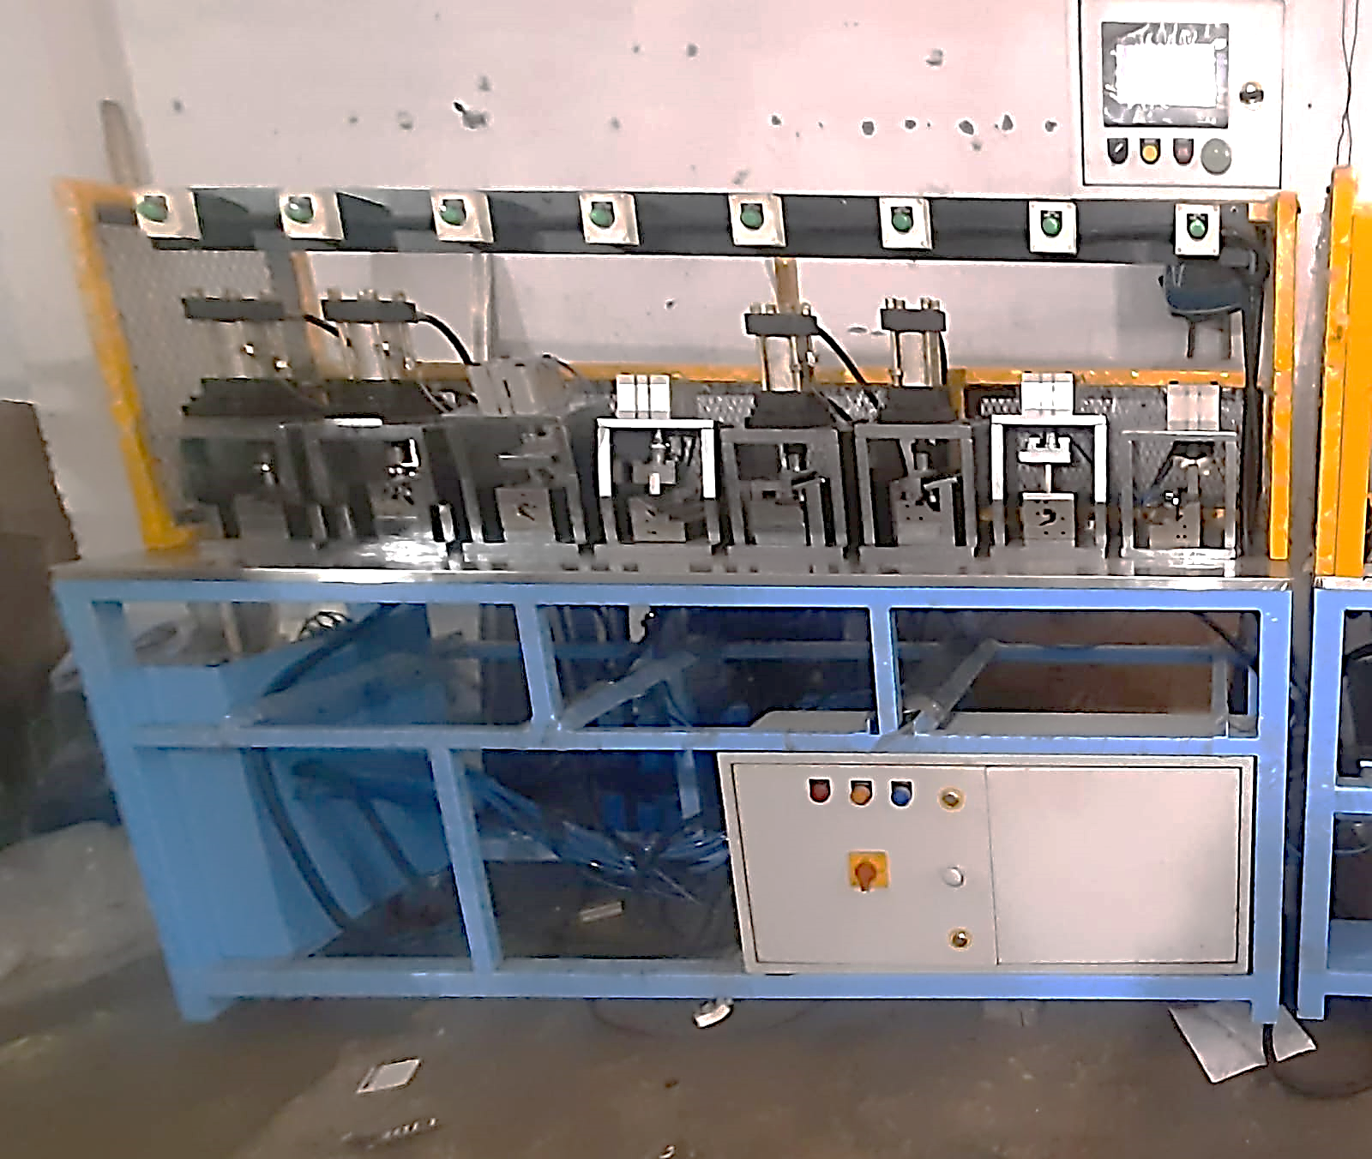
Outer Belt CUT and Notch machine

Slide 11
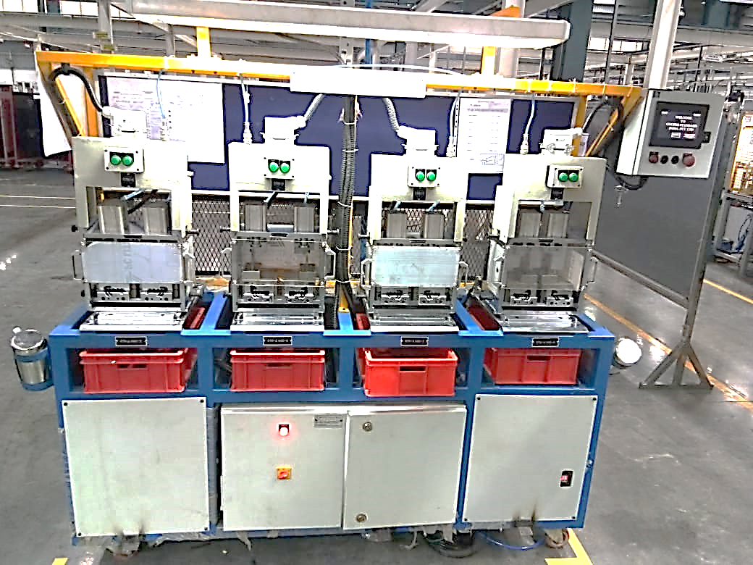
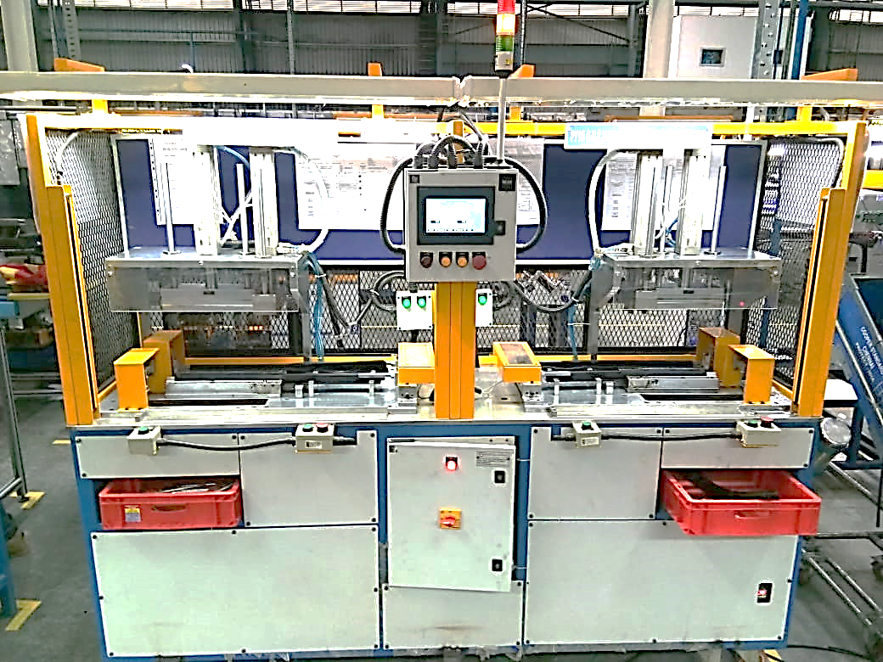
Glass Run Notching Machine
Glass Run Notching Machine

Slide 12
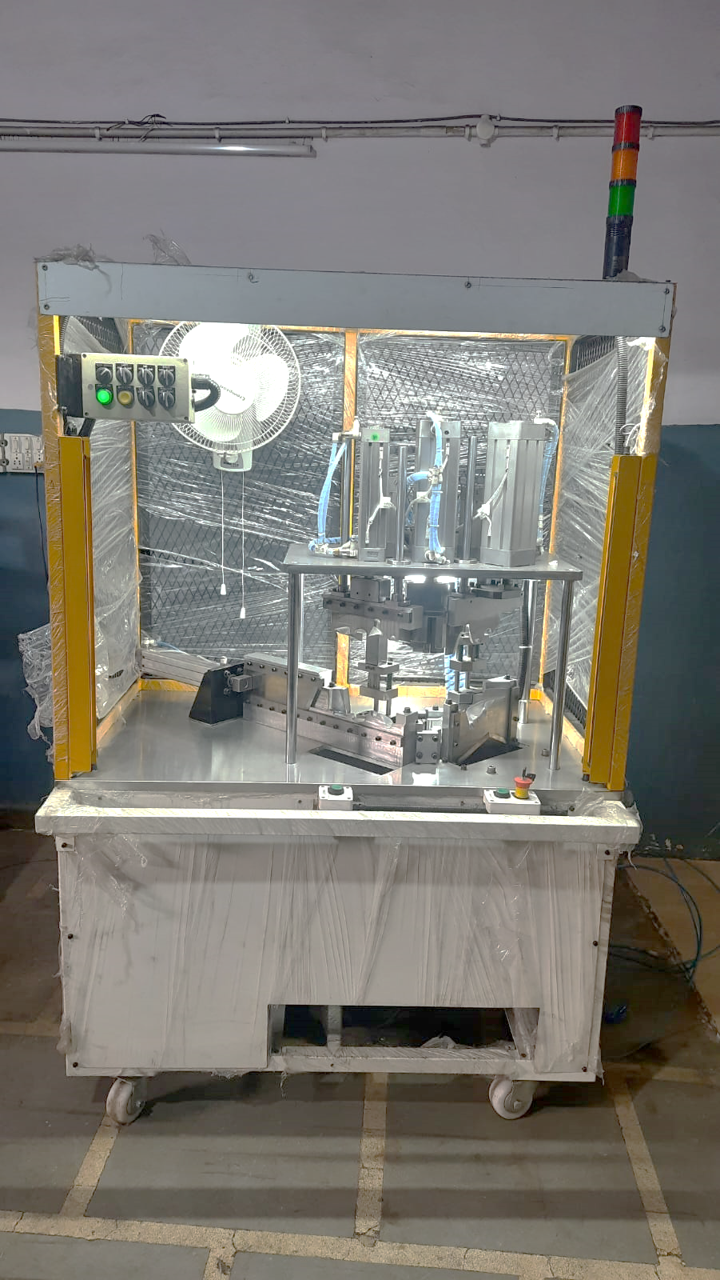
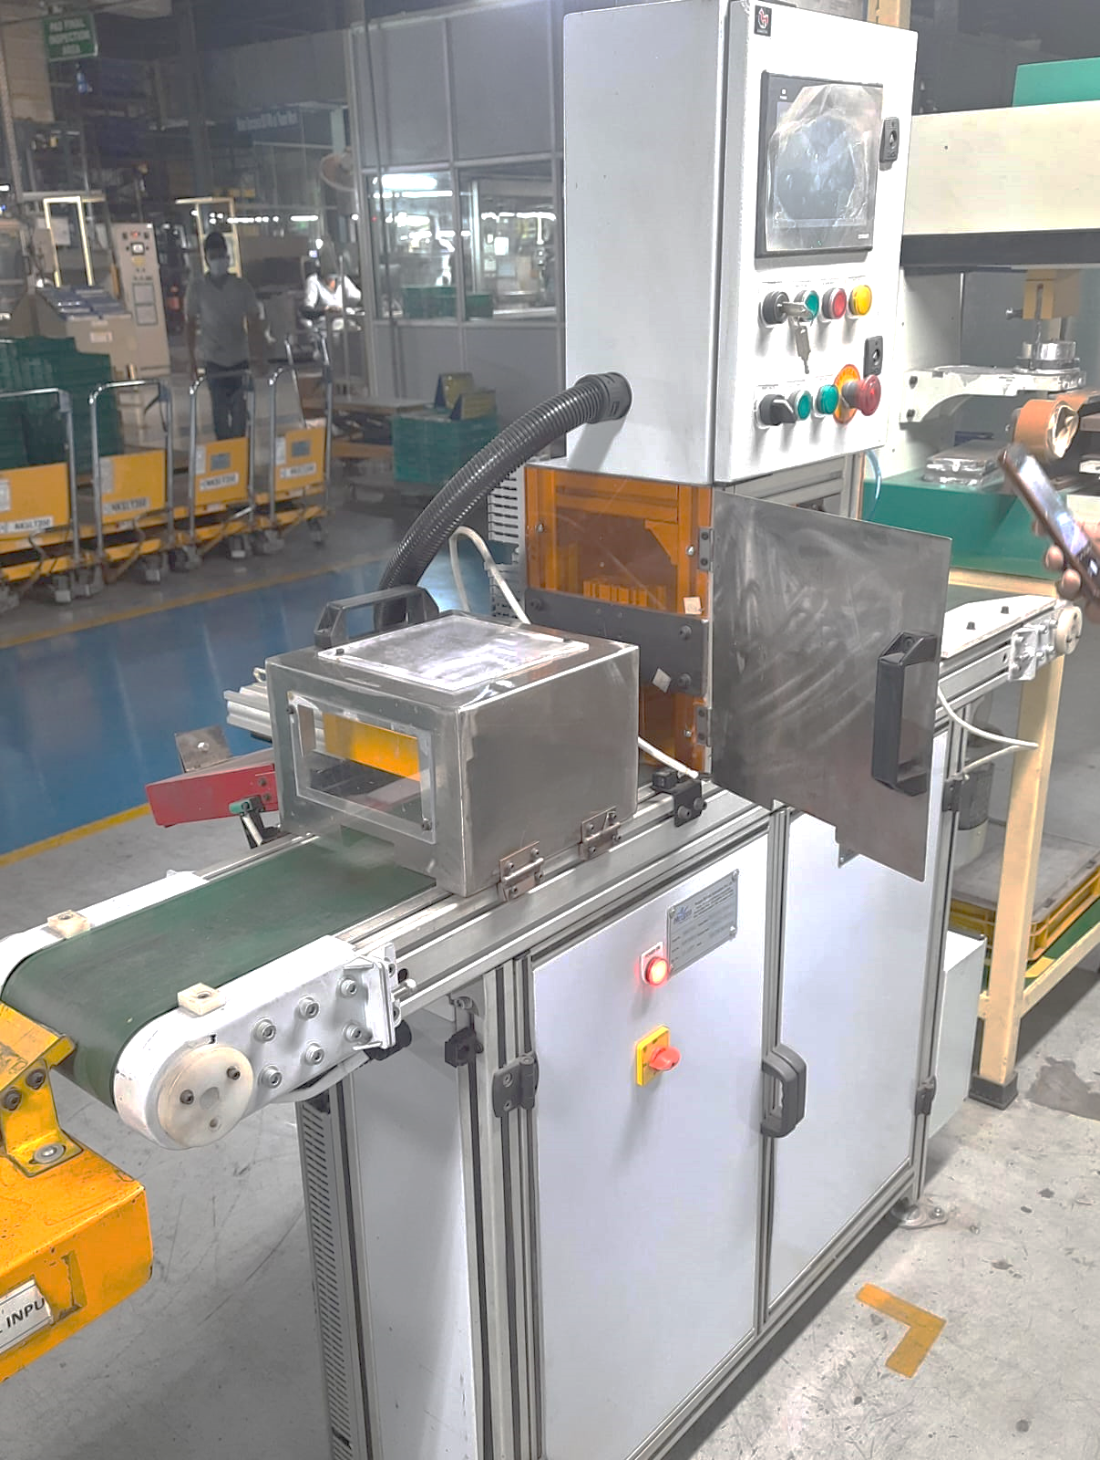
Blow mould cut, drilling and Punching machine
Bar code marking and inspection machine

Slide 13
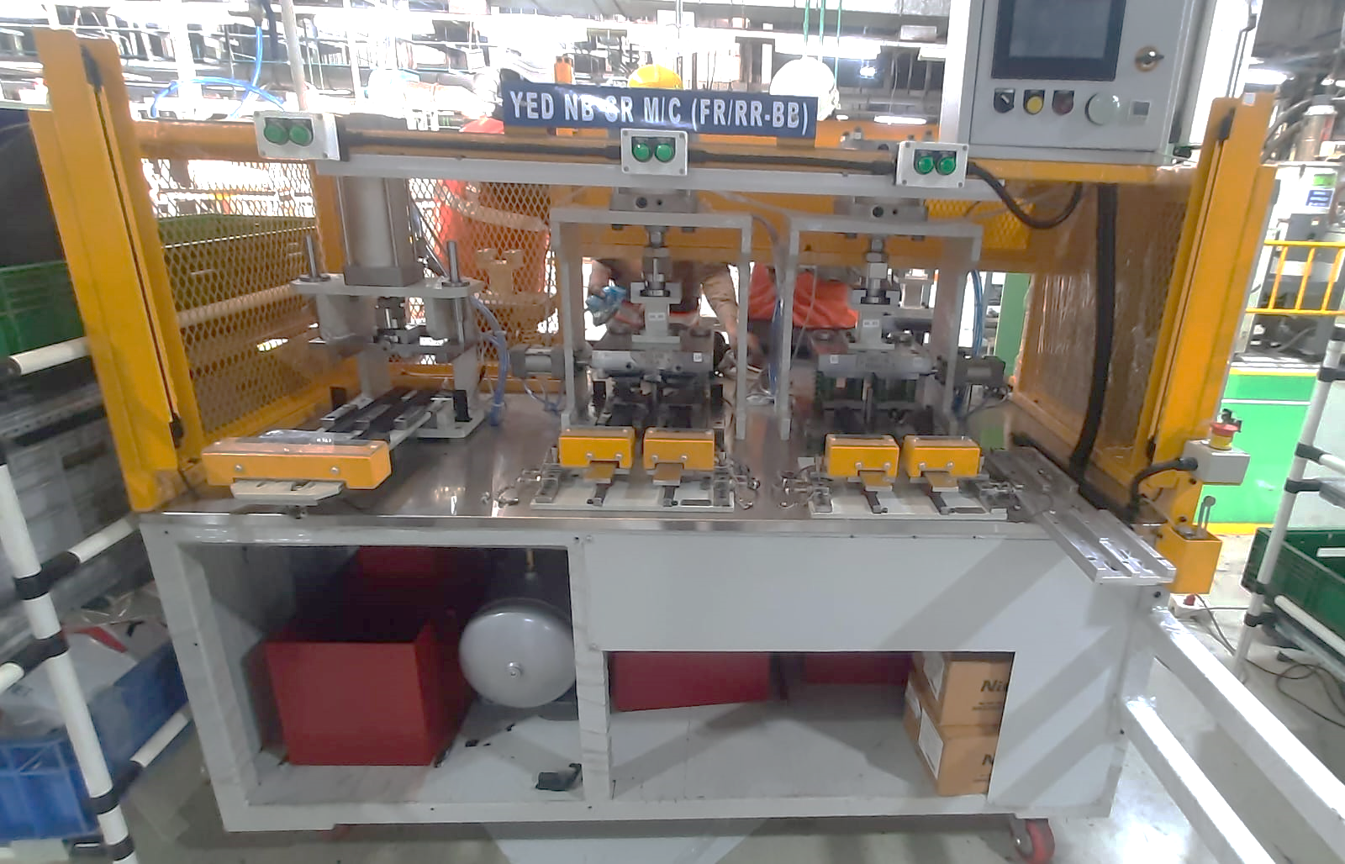
Glass run CUT and Notch machine

Slide 14
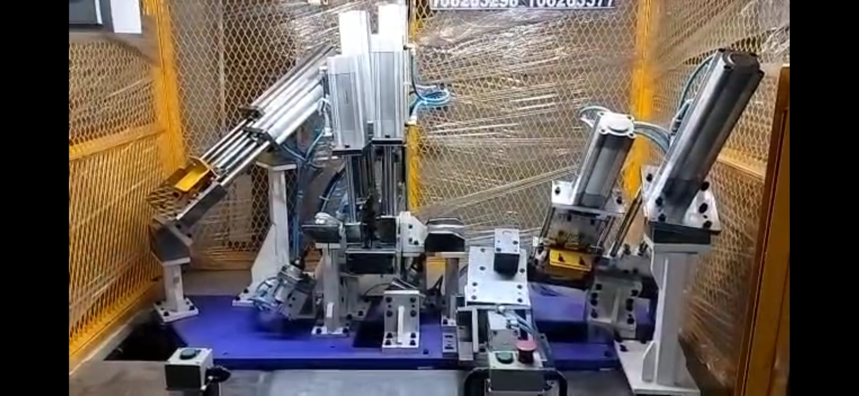
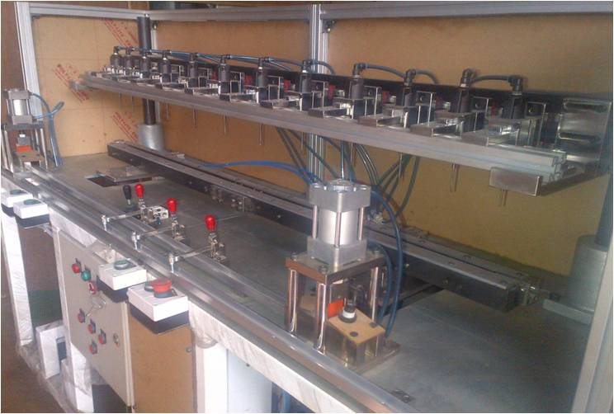
Blow mould cut, drilling and Punching machine
Belt notching Tool
Door seal CTL and Gang drill SPM

Slide 15
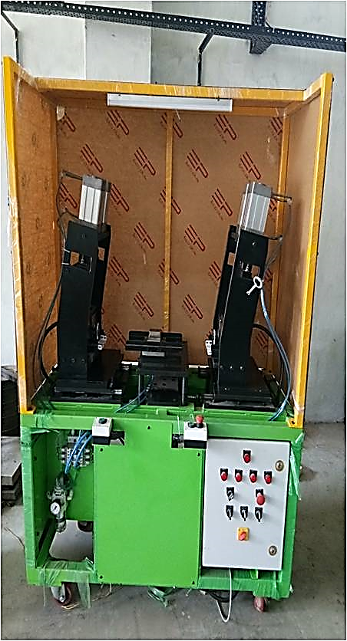
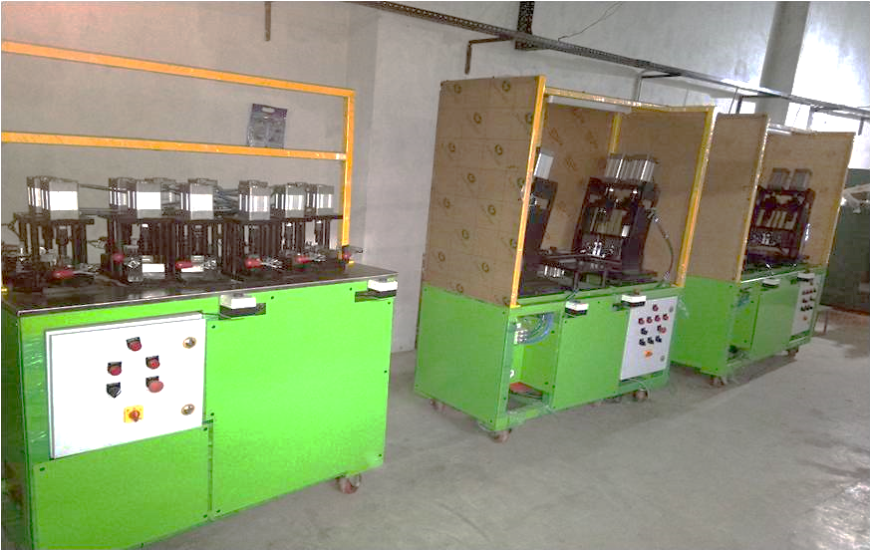
Forming rollers
Outer belt machines
Inner belt machine

Slide 16
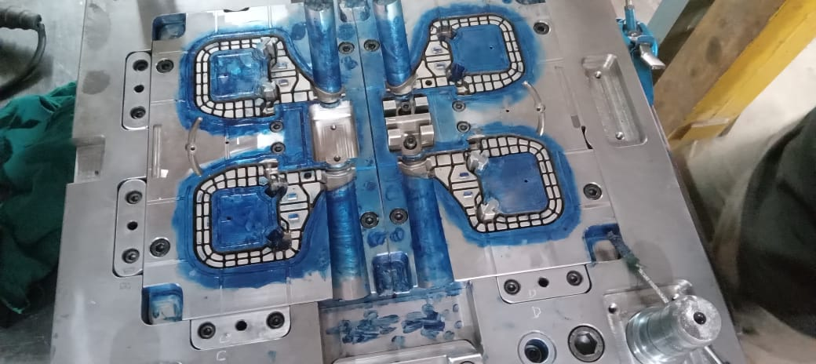
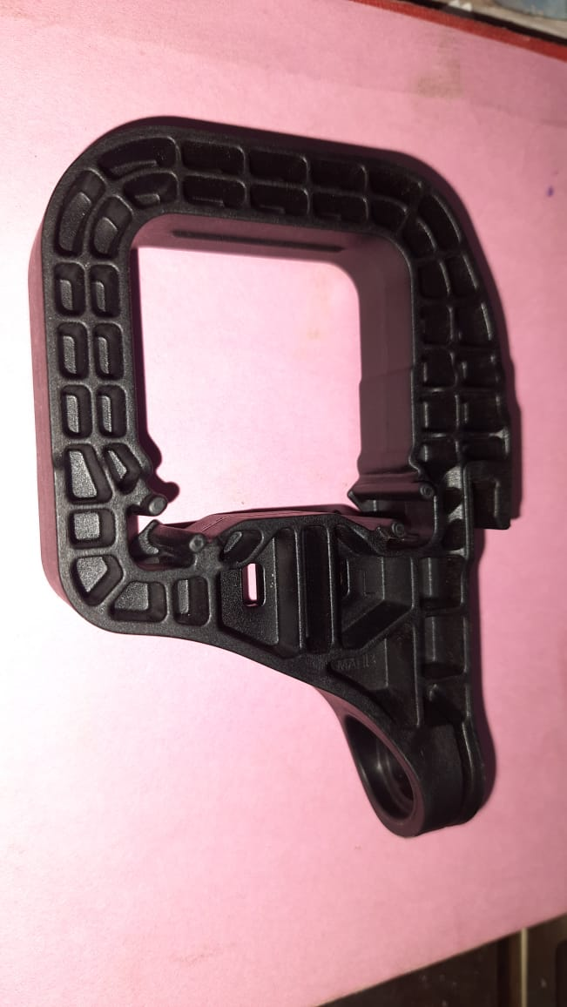
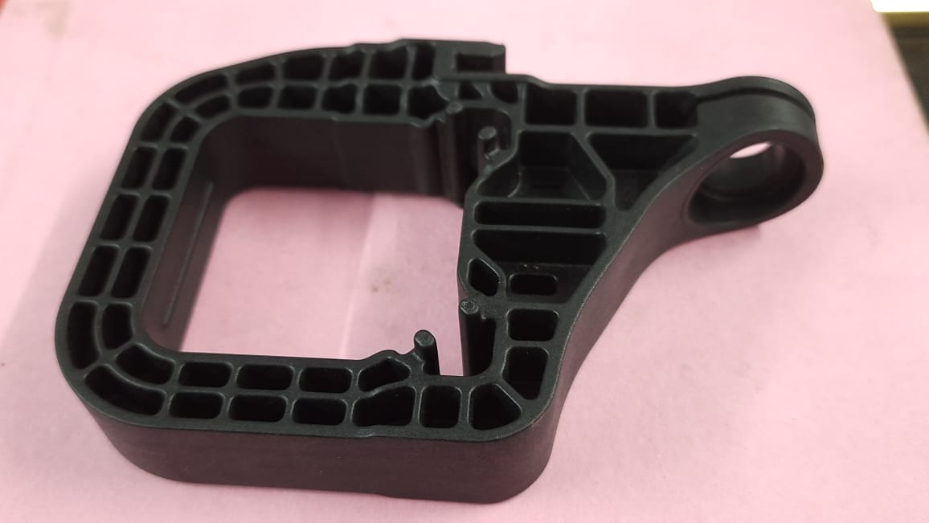
Plastic mould
Plastic moulded Part

Slide 17
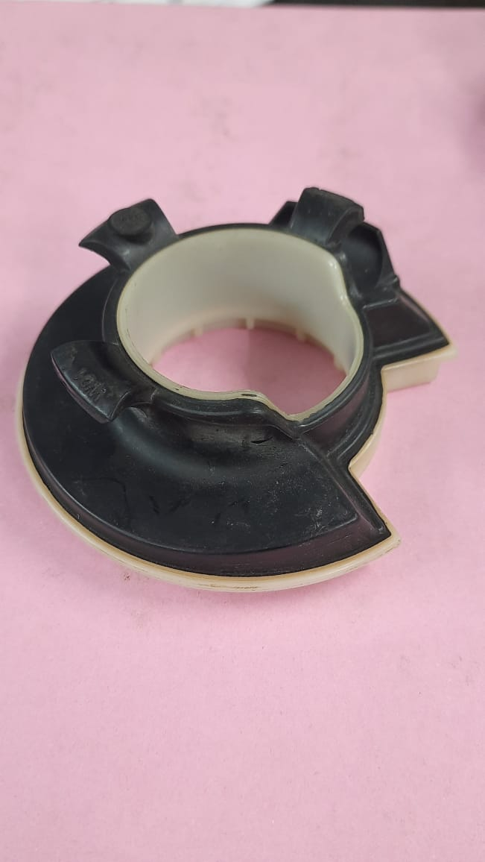
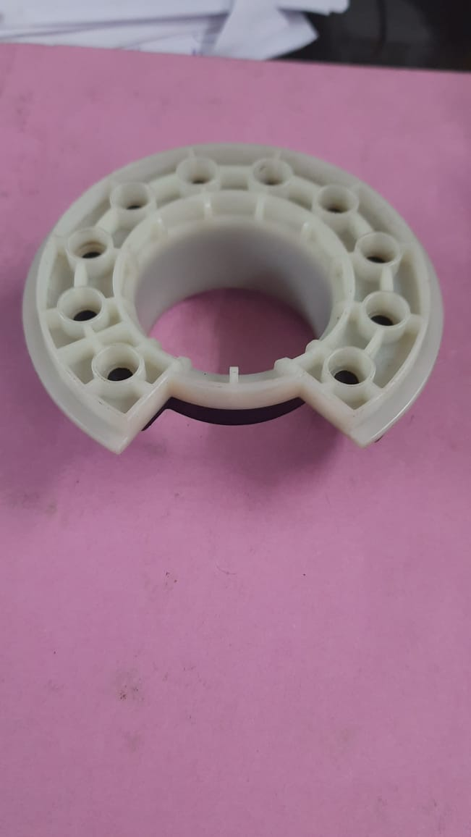
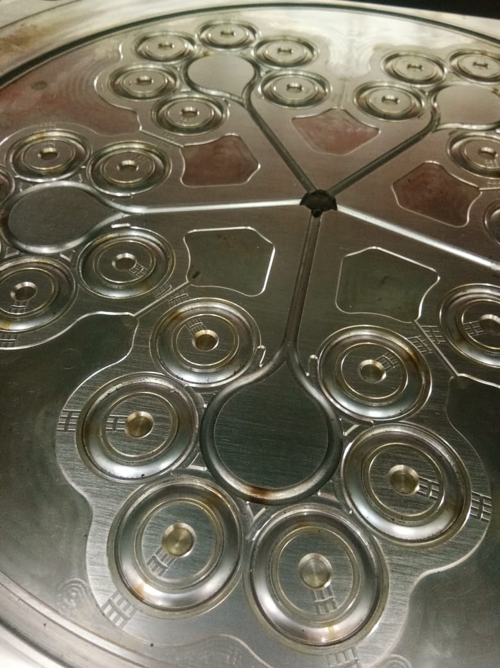
Plastic moulded Part
Plastic mould

Slide 18
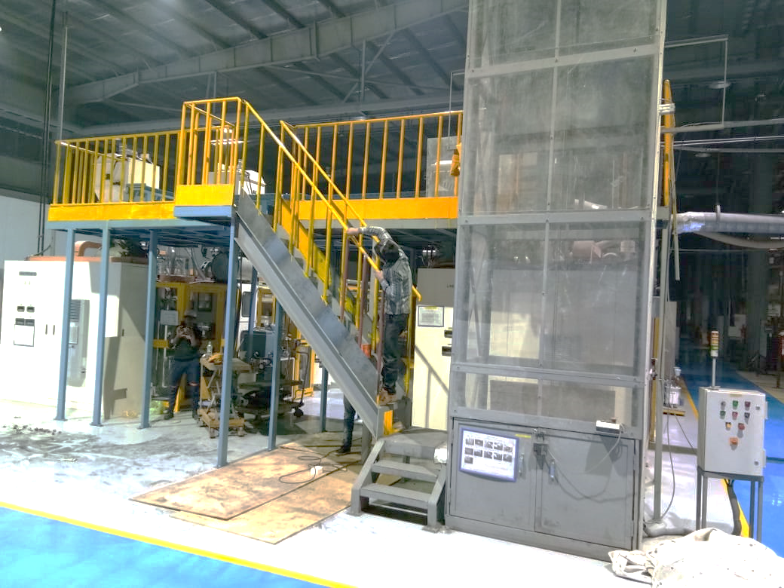
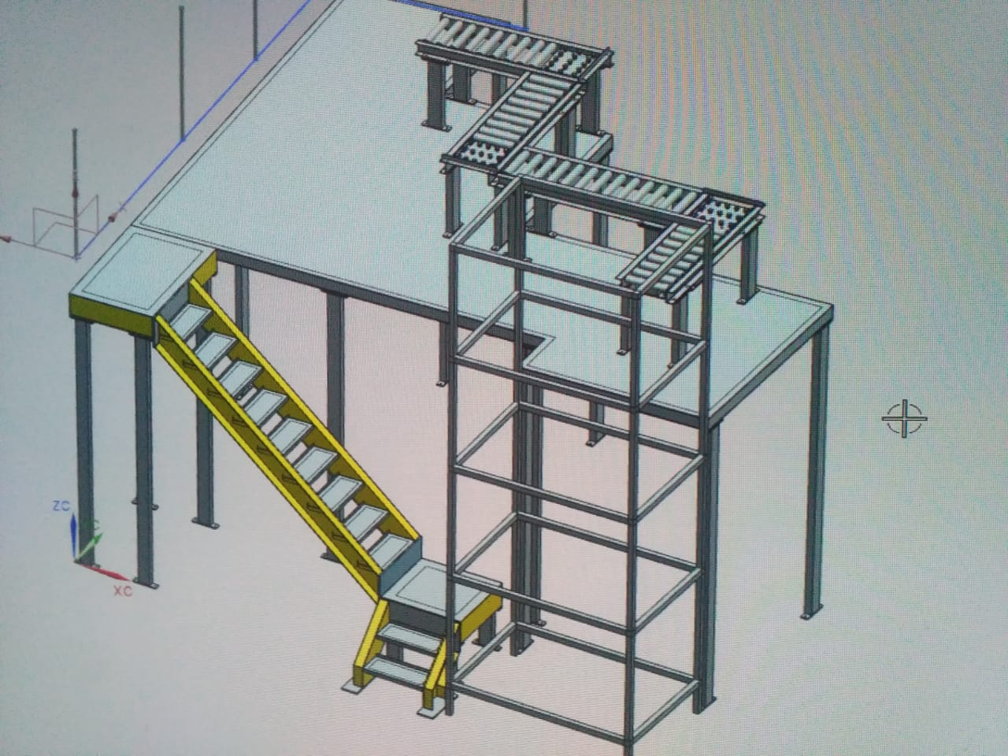
Fabrication work Projects

Slide 19
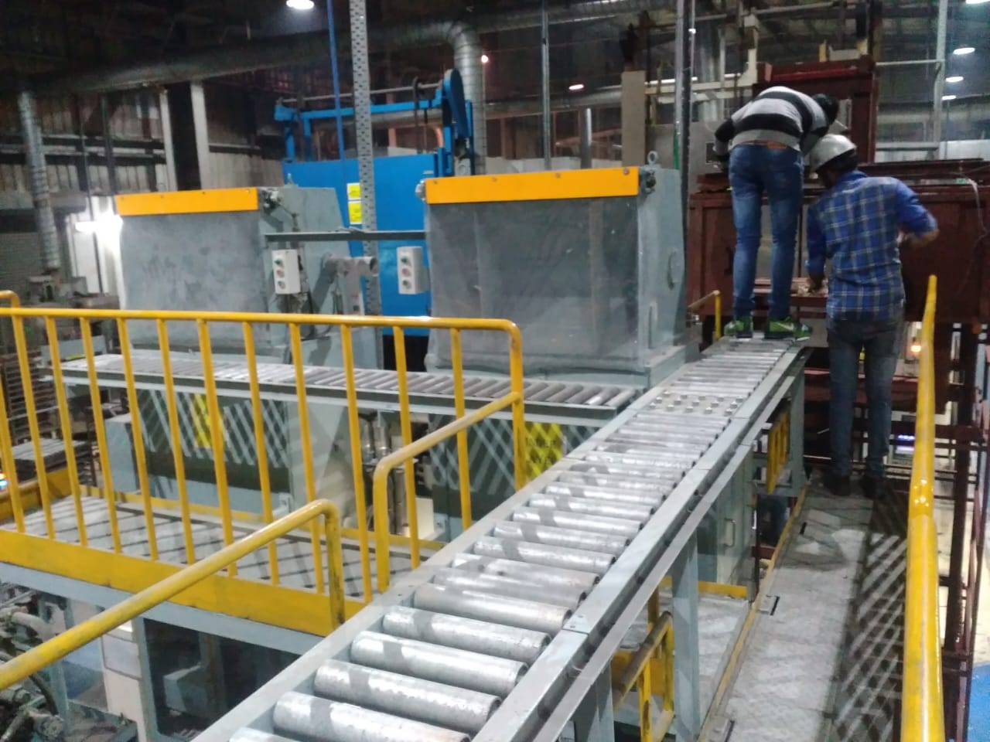
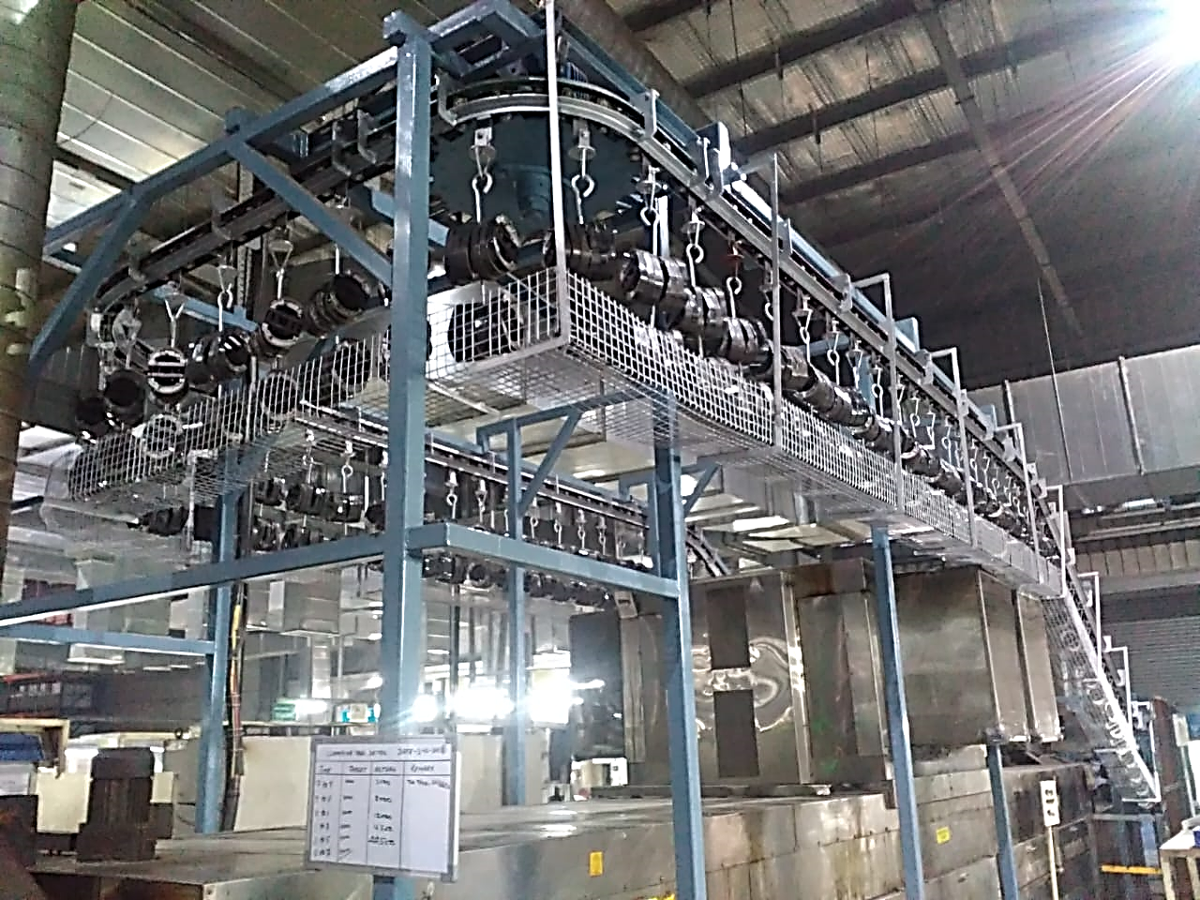
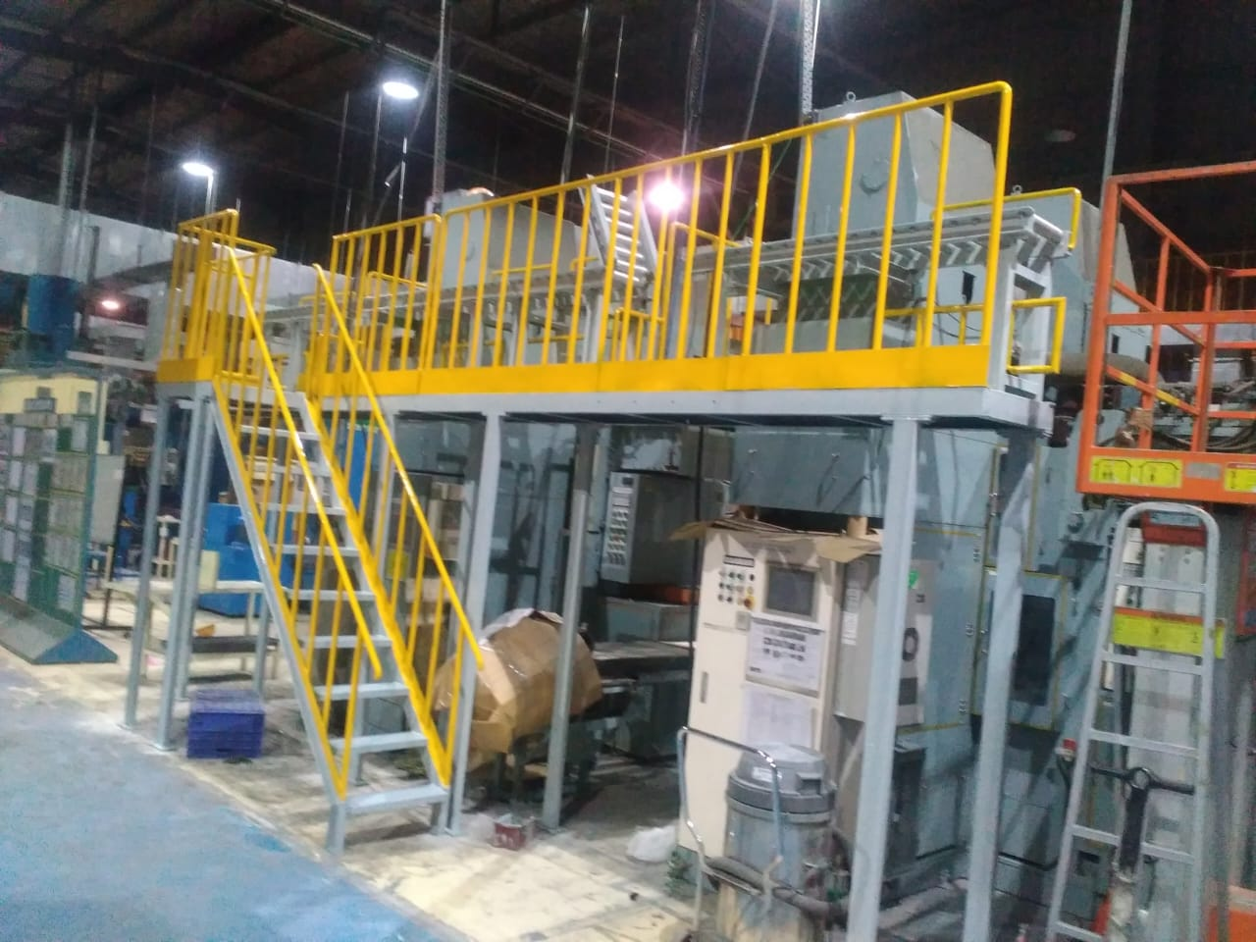
Fabrication work Projects

Slide 20
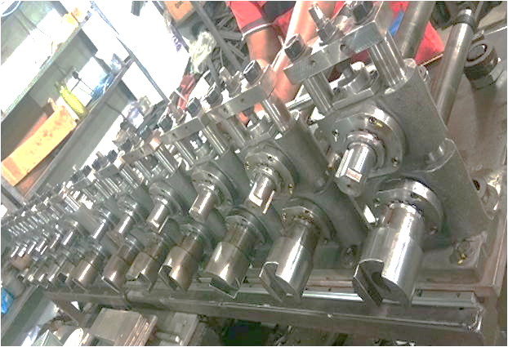
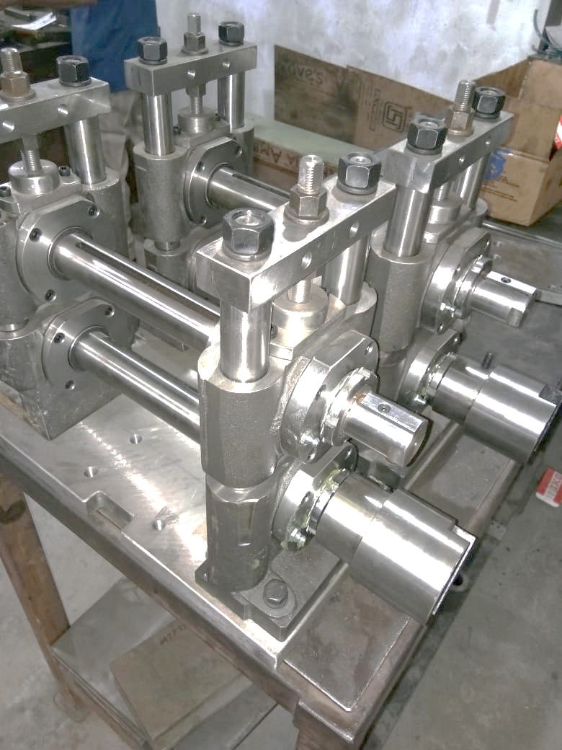
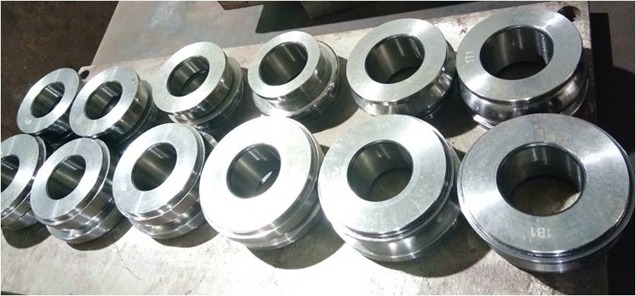
Roll Mill and Rollers for SS Outer Belt

Slide 21
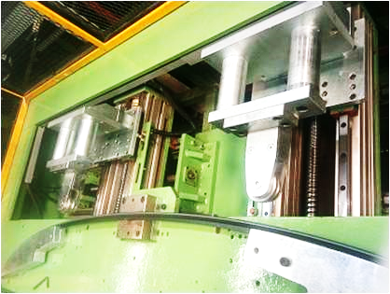
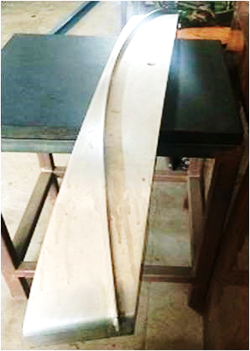
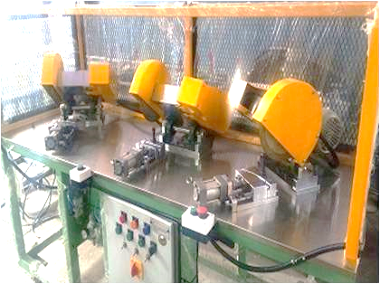
Bottom windshield checking gauge
Bottom windshield 4 servo bending Spm
OUTER BELT CUTTING Spm

Slide 22
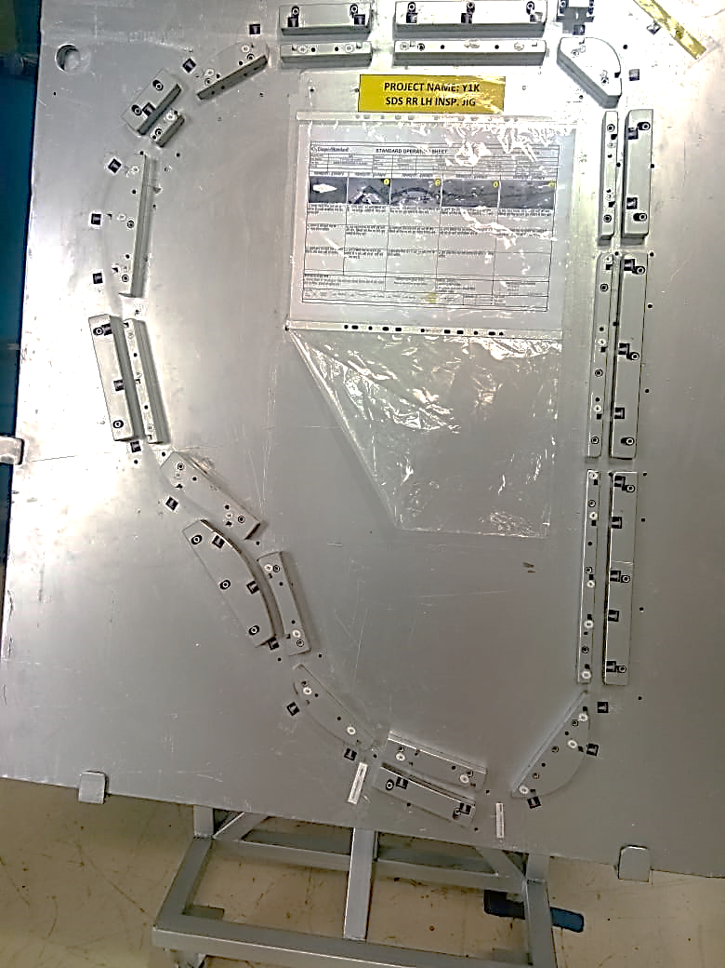
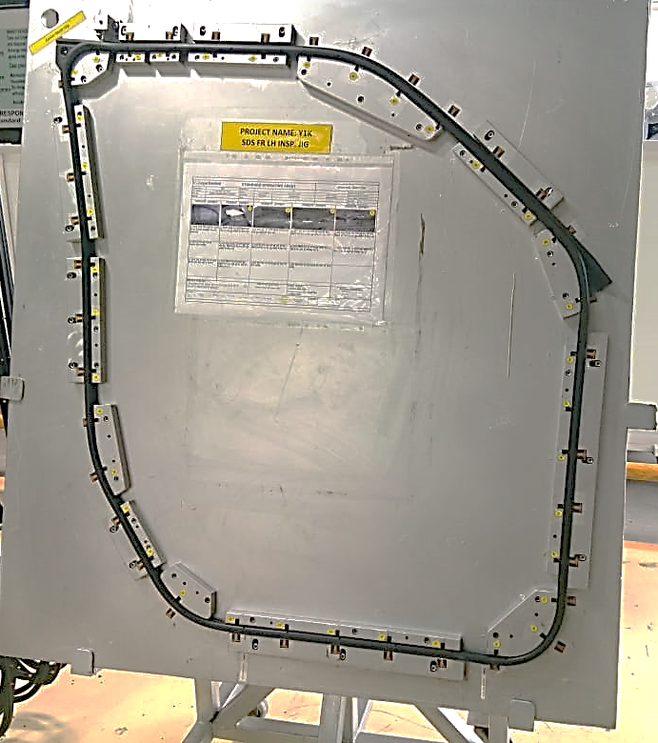
Rear Door seal Clip pitch inspection fixtures
Front Door seal Clip pitch inspection fixtures

Slide 23
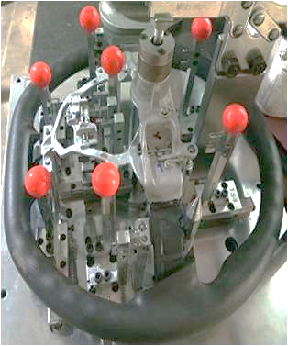
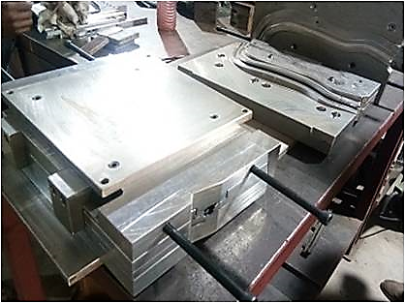
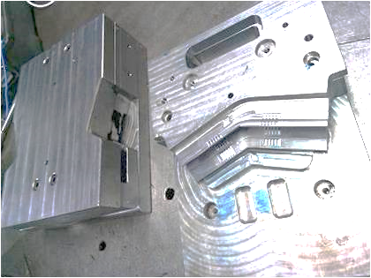
MOULDS
STEERING CHECKING GAUGE

Slide 24
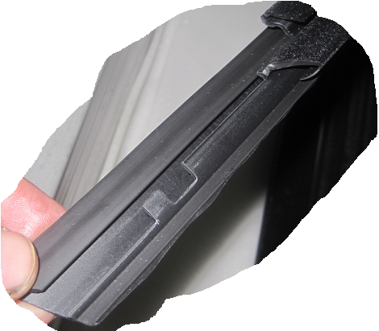
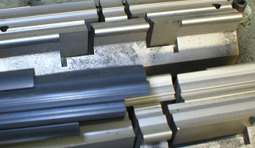
Products/Services
Job Work on CNC Wire cut Mitsubishi.
Job work on VMC Cosmos VCM1060 and 640
SPMs
Laser cutting and CNC bending
Press tools for sheet metal parts(progressive, compound)
Machined components
Notching and cutting tool for Rubber Weather strip
SPMs for Rubber weather-strip
Weather strip rollers and rolling mill stand.
Rubber moulds of Compression, Transfer and Injection type
Moulds for Break pad
Plastic moulds
Jigs/fixtures
Forming Rollers
Checking Gauges

Slide 25
Our Esteemed customers
ALP Nishikawa P Ltd, Gurgaon.
ALP Overseas
Motherson Automotive and Technologies System
AJF friction Pvt Ltd, Neemrana ( Hitachi company)
SFC Solutions (Cooper Standard) India Pvt Ltd.
PPAP Tokai Rubber P Ltd, Greater Noida
Bharat Seats Ltd
Ingress Autoventures Pvt Ltd, Gurgaon
Toyoda Gosei Minda India Pvt Ltd, Neemrana.
WOCO Tech Elastomere pvt ltd
Vibracoustic India Pvt Ltd
Machinoplast Manesar
Bohra Rubber Ltd, Faridabad
Dellner polymers, UK
Ferrabyrne Autocomp, UK
Vossloh Cogiffer Signalling I Pvt Ltd

Slide 26
Contact details
Lalit Kumar
M/S KARTIK Tools and Moulds
Plot No 174D, Anand Industrial Estate
Mohan Nagar, Ghaziabad (U.P)
Mobile: +91-9899292025, 8076470172
Email ID: lalit.kartiktools@gmail.com; lalit.kumar@rediffmail.com
GSTIN No: 09AINPK9856B1ZT

